Slide 1
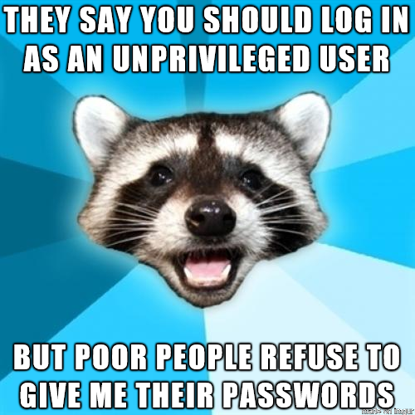
Risk Adaptive Access Control
http://m.eado.ws/cm2017-RAdAC
Michael Meadows
@AntiArchitect
https://github.com/WalkingDisaster
http://m.eado.ws

Slide 2


Impractical Security

Slide 3
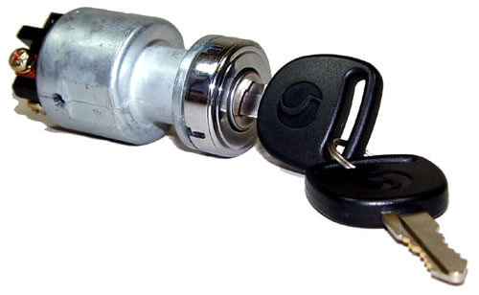
Too Little

Slide 4
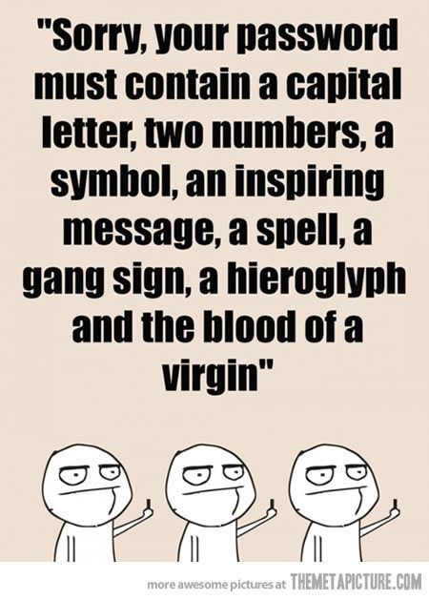
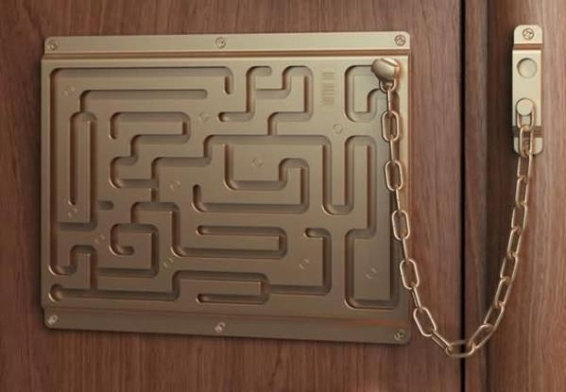
Too Much

Slide 5
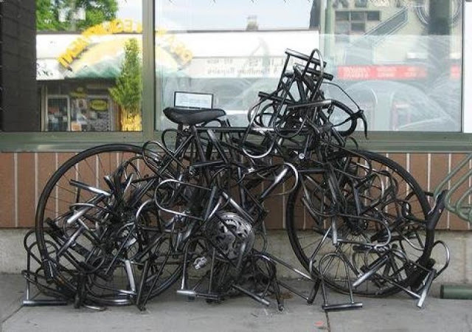
Balance?

Slide 6
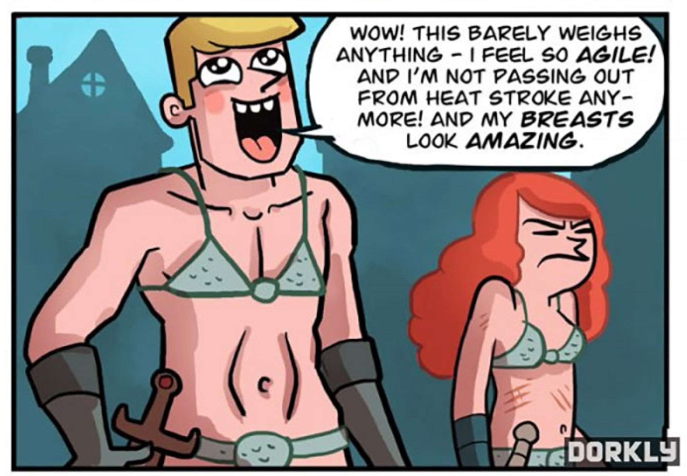
What Users Want

Slide 7
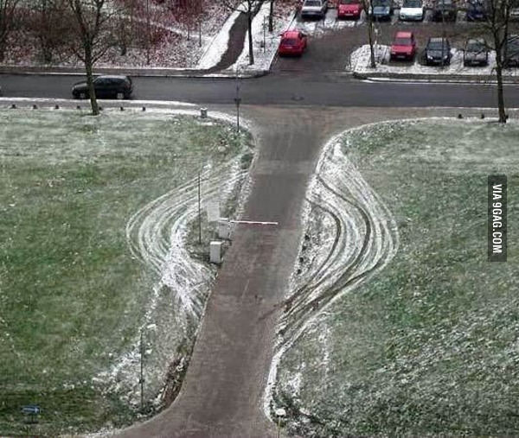
Reality

Slide 8
For Example…
123456
password
12345678
qwerty
12345
123456789
football
1234
1234567
Baseball
welcome
1234567890
abc123
111111
1qaz2wsx
dragon
master
monkey
letmein
Login
princess
qwertyuiop
solo
passw0rd
Starwars
For a good read the NIST 800-63B specification. Especially Appendix A—Strength of Memorized Secrets

Slide 9


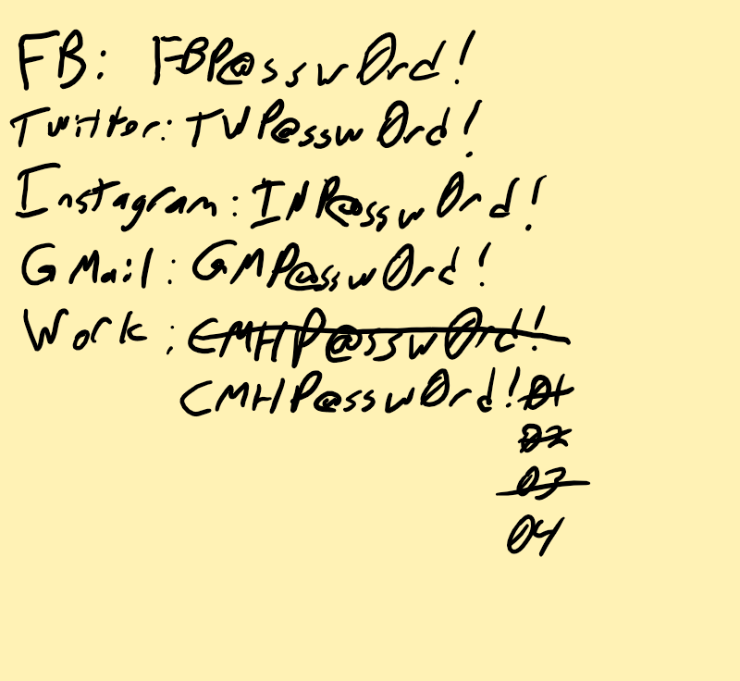
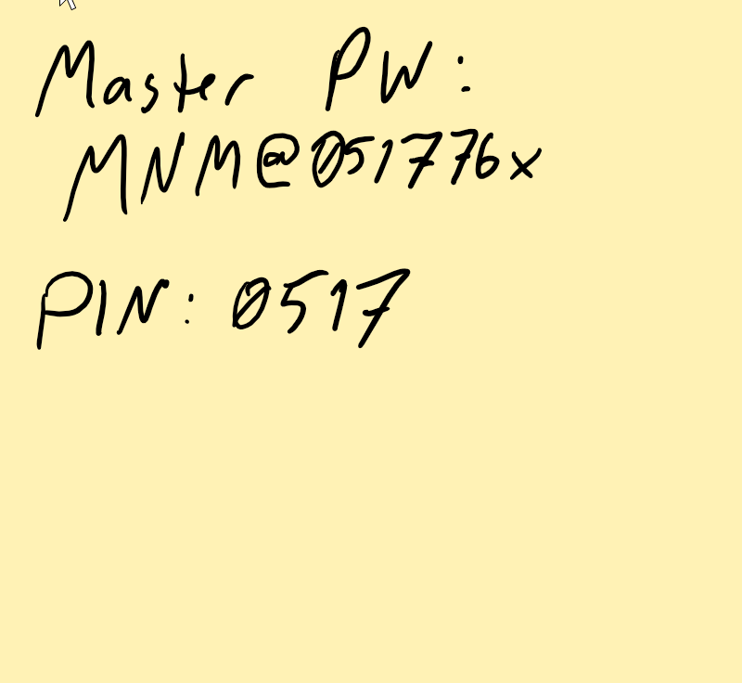
Humans are Hackable
Uses Mom’s Email for Online Games
Installs Games on Dad’s Phone
Work Emails on Phone

Slide 10

Access Control Policies

Slide 11
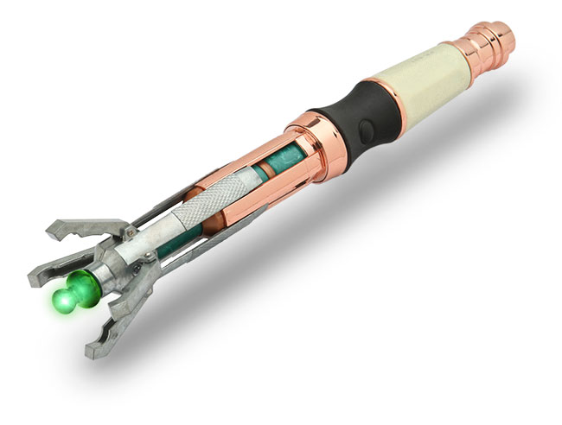

ACL
Notes:
https://www.troyhunt.com/website-enumeration-insanity-how-our-personal-data-is-leaked/

Slide 12
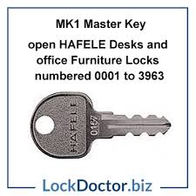


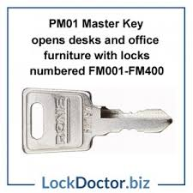
Mandatory Access Control

Slide 13
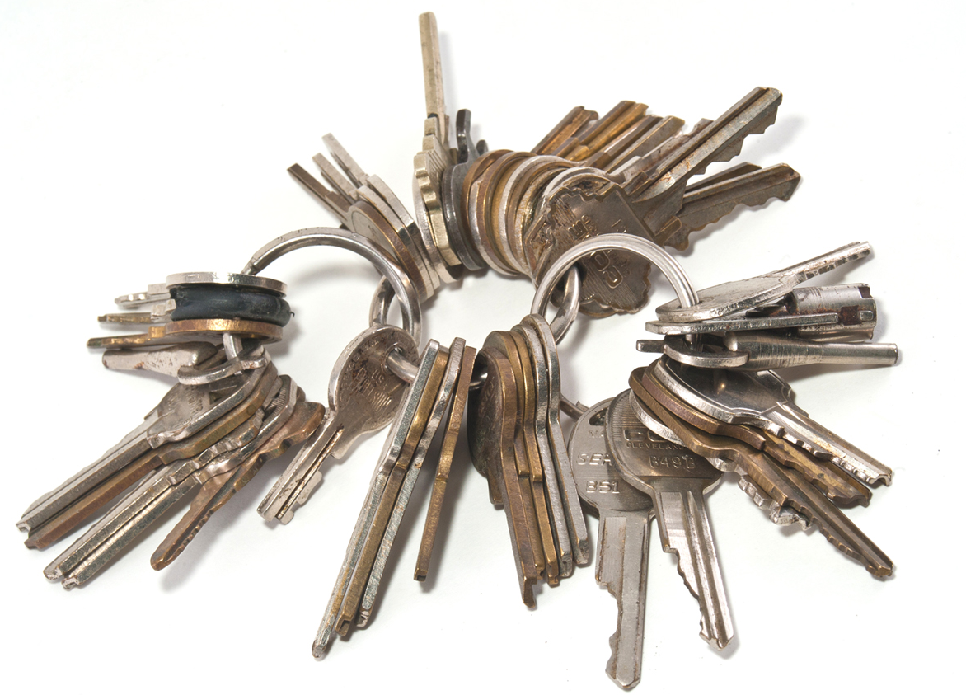
Discretionary Access Control

Slide 14
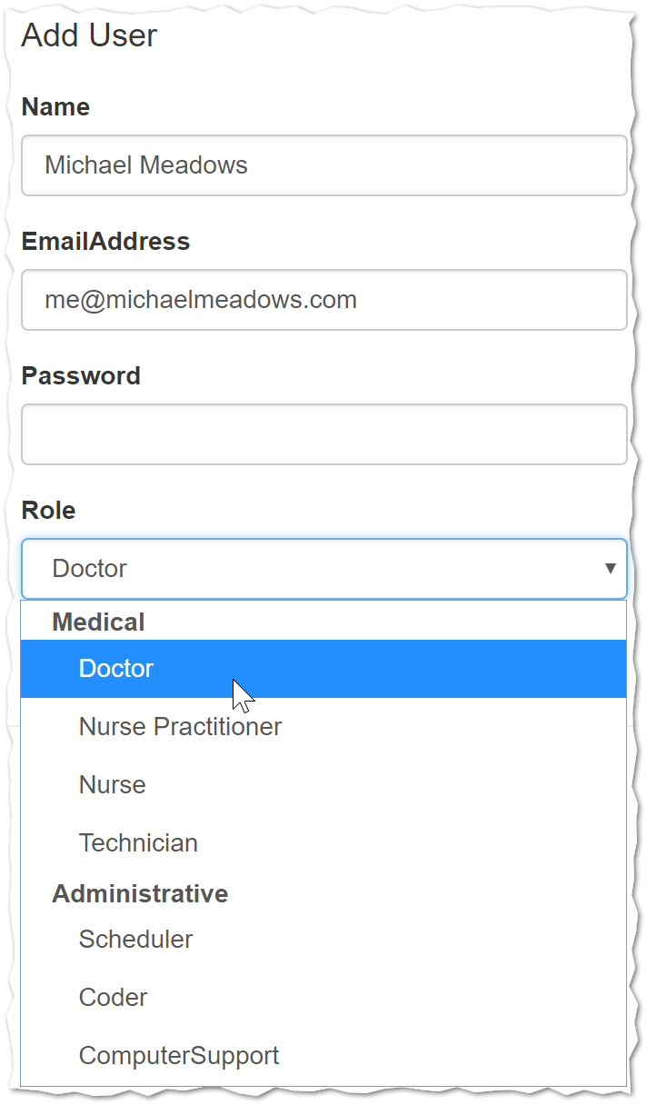
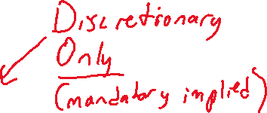
Role Based Access Control ☹

Slide 15
RBAC Example
As a Doctor (role)
Who is performing a case review
I can see a patient’s history
As a Doctor (role)
Who is preparing for a patient visit
I can see a patient’s history

Slide 16

Traditionally Secure

Slide 17

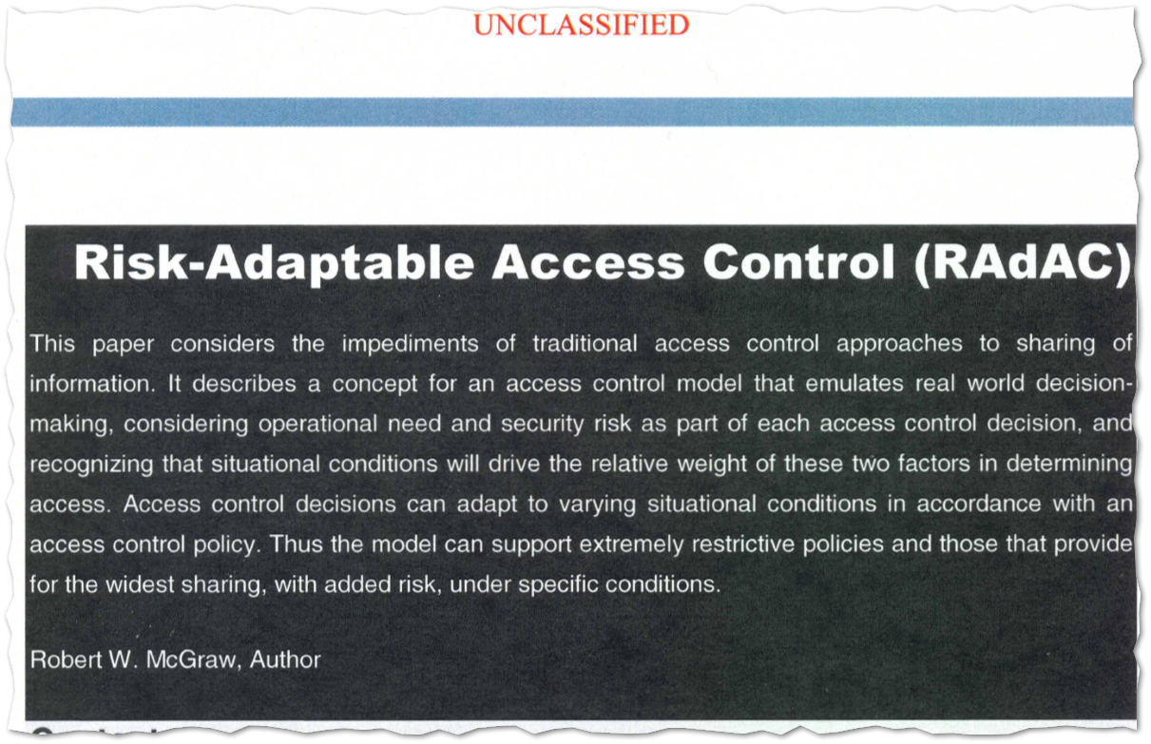
Risk Adaptive
Notes:
Robert W. McGraw (NIST RAdAC paper) https://csrc.nist.gov/CSRC/media/Events/Privilege-Management-Workshop/documents/radac-Paper0001.pdf

Slide 18
RAdAC Example

Slide 19
Operational Need Override
As a doctor
Who is preparing for an upcoming visit
Or is performing a case review
For a patient currently under my care
Or a current patient of a doctor who reports directly to me
I must be able to see a patient’s history.

Slide 20

Risk Evaluation I Can Haz teh Dataz
Key | Value
Label | 1
User | Dr. Shemp Howard
Role | Doctor
MandatoryAccess | Update::ePHI
DiscretionaryAccess | Patient Appointment
IpAddress | 10.10.5.3
DayOfWeek | 3
DayOfMonth | 4
HourOfDay | 15
IsWeekend | FALSE
IsHoliday | FALSE
UserSecondsSinceLastRequest | 528.224
UserRequestsInLastMinute | 0
UserRequestsInLastTenMinutes | 1
AllRequestsInLastMinute | 6
AllRequestsInLastHour | 43
AllRequestsInLastDay | 350
Key | Value
Scored Probability | 0.42254486

Slide 21
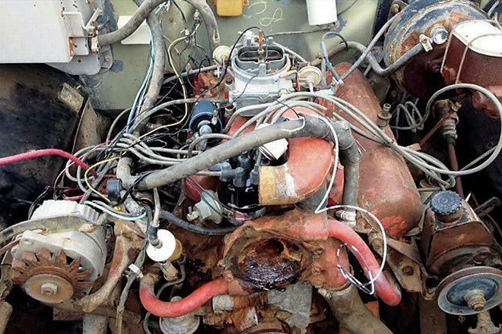
Let’s Talk Implementation
ASP.Net Authorization Policies
Machine Learning
Unmasking

Slide 22
Authorization Policies
Authorization
Role
Policy
Requirement
Handler
Claim
Claim

Slide 23
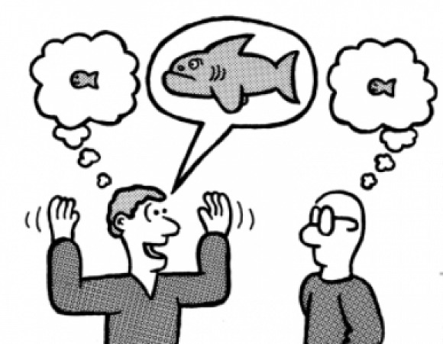
The Claims
if (userName == "Dr. Curly Howard")
{
return new[]
{
new Claim(ClaimTypes.Role, Roles.Doctor, typeof(string).ToString(), Issuers.Self),
new Claim(Claims.Employee, true.ToString(), typeof(bool).ToString(), Issuers.Self),
new Claim(Claims.Certificates.Hipaa, DateTime.UtcNow.AddYears(1).ToString("O"), typeof(DateTime).ToString(), Issuers.Self)
};
}
if (userName == "Dr. Larry Fine")
{
return new[]
{
new Claim(ClaimTypes.Role, Roles.Doctor, typeof(string).ToString(), Issuers.Self),
new Claim(Claims.Employee, true.ToString(), typeof(bool).ToString(), Issuers.Self),
new Claim(Claims.Certificates.Hipaa, DateTime.UtcNow.AddDays(-1).ToString("O"), typeof(DateTime).ToString(), Issuers.Self)
};
}
if (userName == "Dr. Shemp Howard")
{
return new[]
{
new Claim(ClaimTypes.Role, Roles.Doctor, typeof(string).ToString(), Issuers.Self),
new Claim(Claims.Consultant, true.ToString(), typeof(bool).ToString(), Issuers.Self),
new Claim(Claims.Certificates.Hipaa, DateTime.UtcNow.AddYears(1).ToString("O"), typeof(DateTime).ToString(), Issuers.Self)
};
}

Slide 24
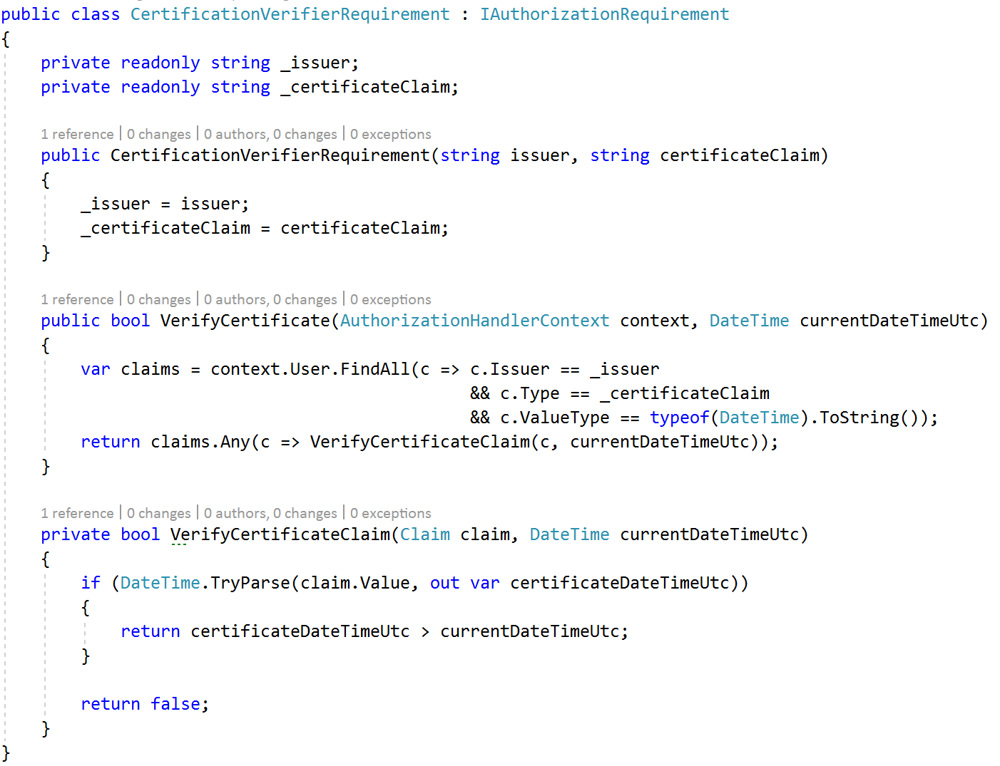
Requirements

Slide 25
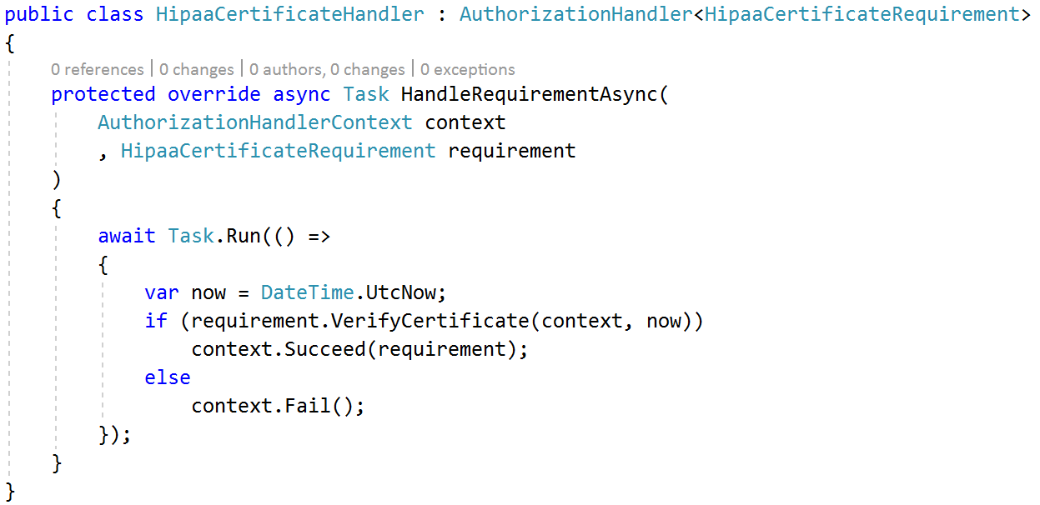
Handlers

Slide 26
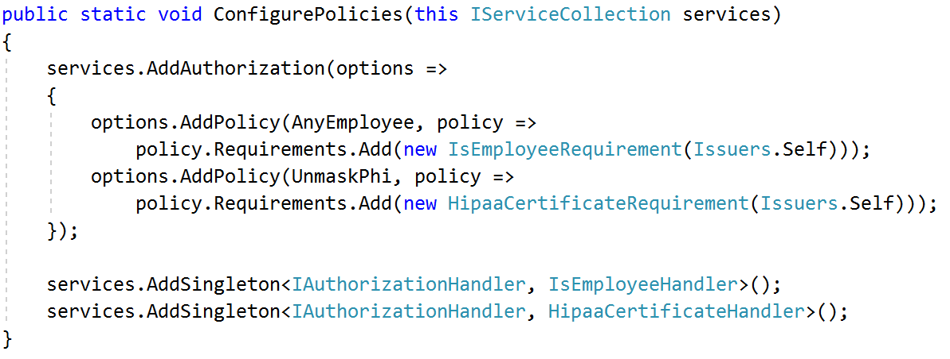
Policy Configuration

Slide 27
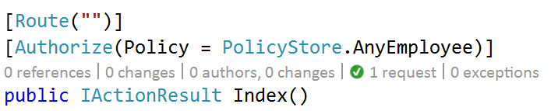
In Controllers

Slide 28
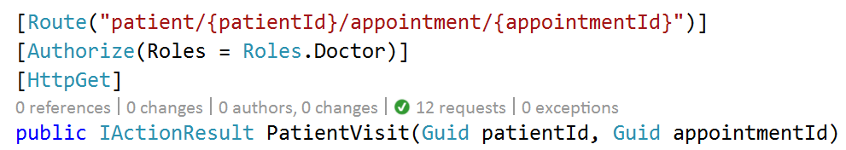
We Can Still Do Roles

Slide 29
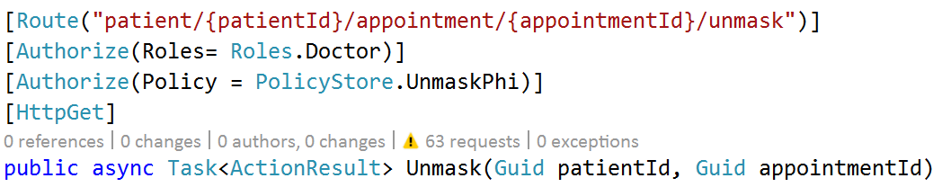
And Multiple Policies Too

Slide 30

Machine Learning

Slide 31
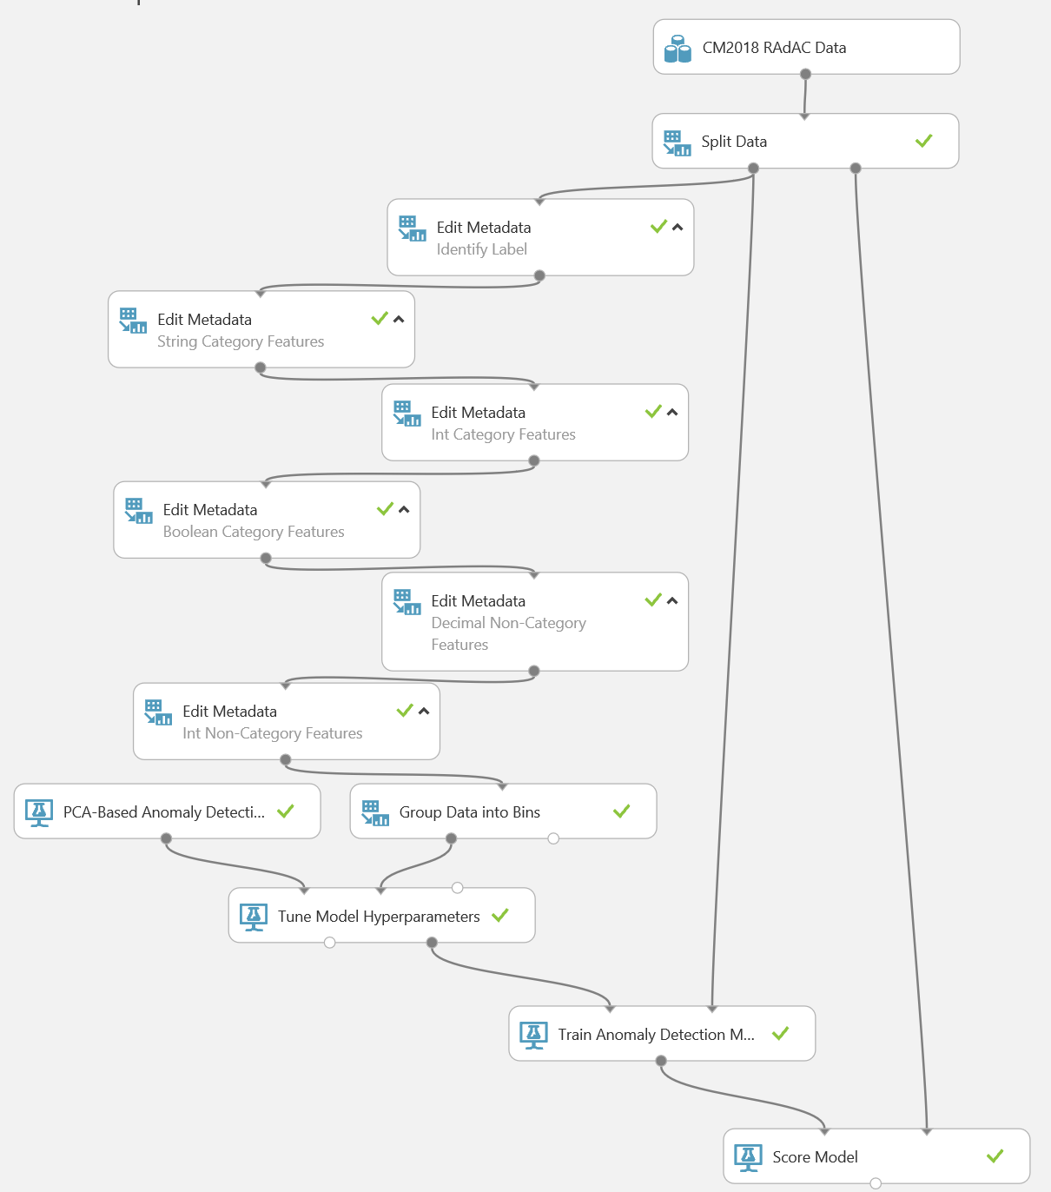
Anomaly Detection
Data Source
Training & Verification Data
Metadata
Labels
Categorical Features
Non-Categorical Features
Quantization
Parameter Sweep
Trained Model
Scoring

Slide 32
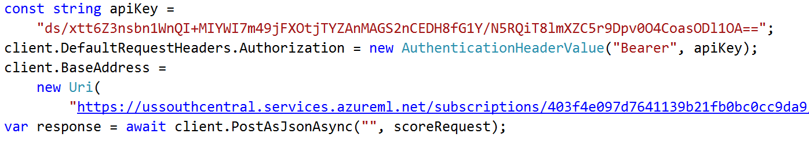
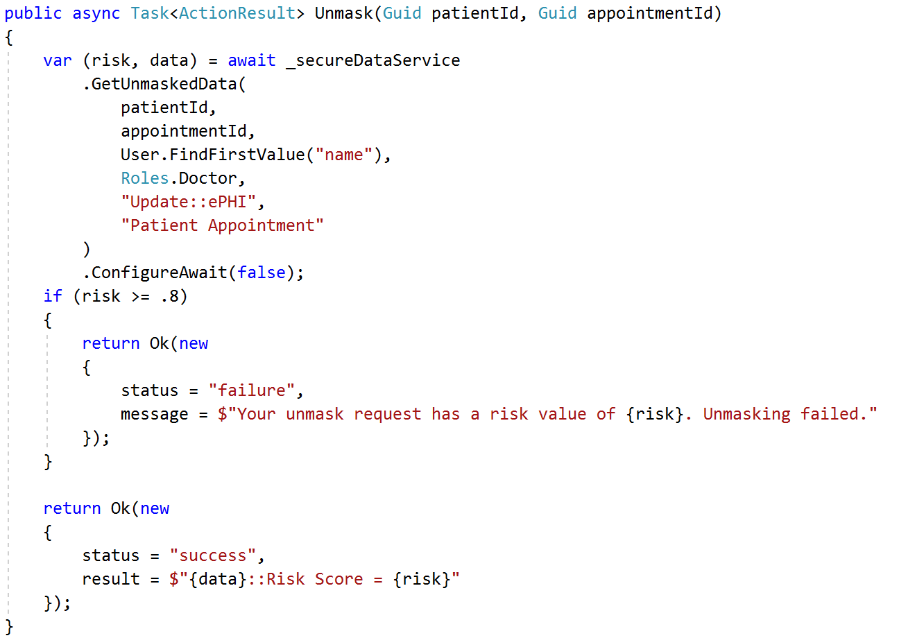
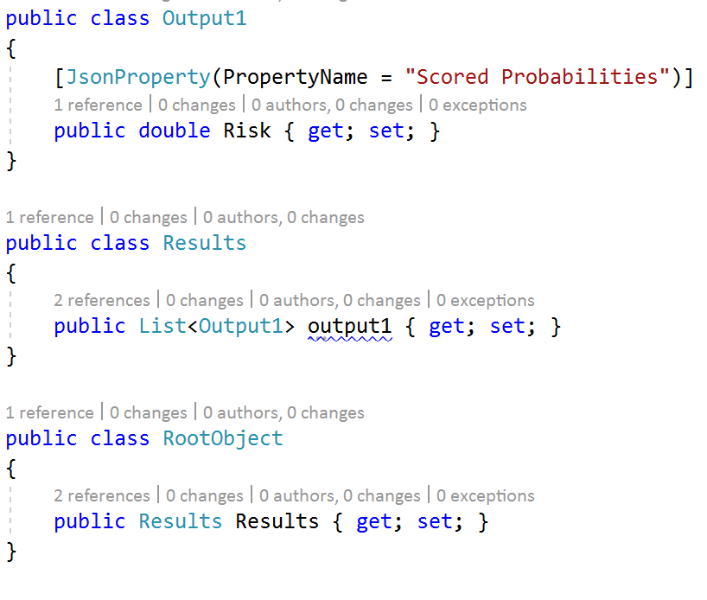
Web Service

Slide 33

Caution
Keep your policies simple at first
Don’t implement ML without real data
Start with static throttling policies
“Observe” ML web service in production before turning on
Start simple, and add more features over time
Remember your users!

Slide 34

Thanks!
Thanks!
m.eado.ws/cm2017-RAdAC

